Slide 1
Lunchtime brownbag: Twitter 101
Daley Chetwynd
(@dchetwynd)

Slide 2
Contents
What is Twitter?
Terminology – tweets, retweets, mentions
Language
Why use Twitter?
Hashtags

Slide 3
What is Twitter?
Social network
Founded in 2006
Users send tweets of < 140 characters
Users can choose to “follow” other users
Users see “timeline” of other users they follow

Slide 4
Terminology
Tweet = single message
Mention = tweet addressed specifically to other user
Retweet = redistribution of another user’s tweet
Retweet != endorsement
Favourite = approval of another user’s tweet
Direct message = private message to user not visible by other users

Slide 5
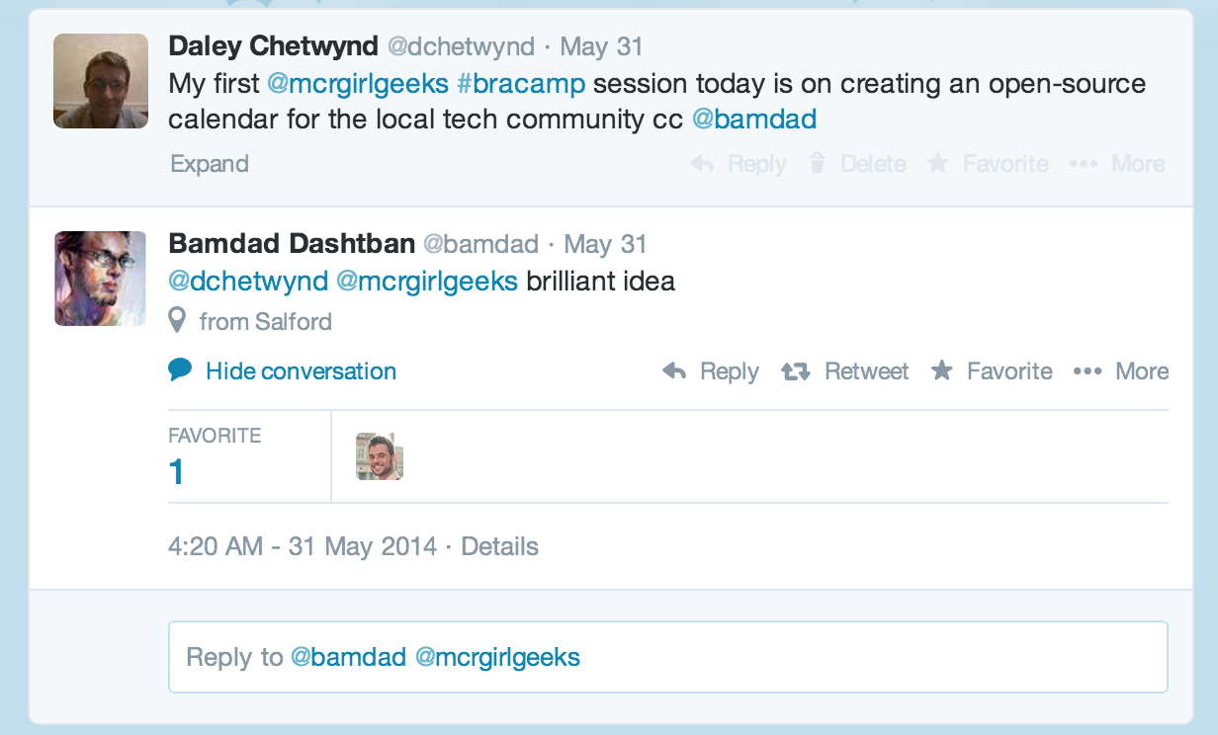
Language
cc = drawing attention of other user to message
OH = overheard, i.e. “OH: You work in PHP. You must have seen loads of strange bugs”
TIL = Today I learned
Tweeps = Twitter people

Slide 6
Why use Twitter?
Personalised information feed
Communicate with like-minded people
Share knowledge with others
Tweet about what you’re interested in
Follow who you’re interested in

Slide 7
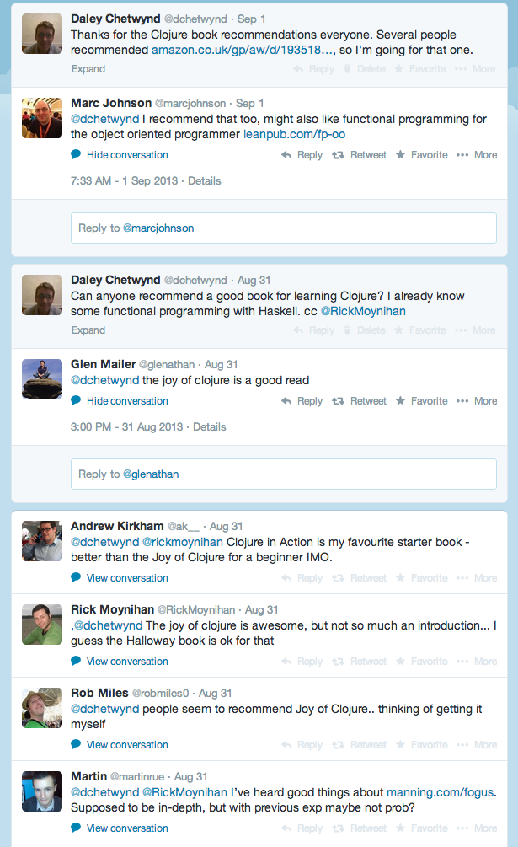
Why use Twitter?

Slide 8
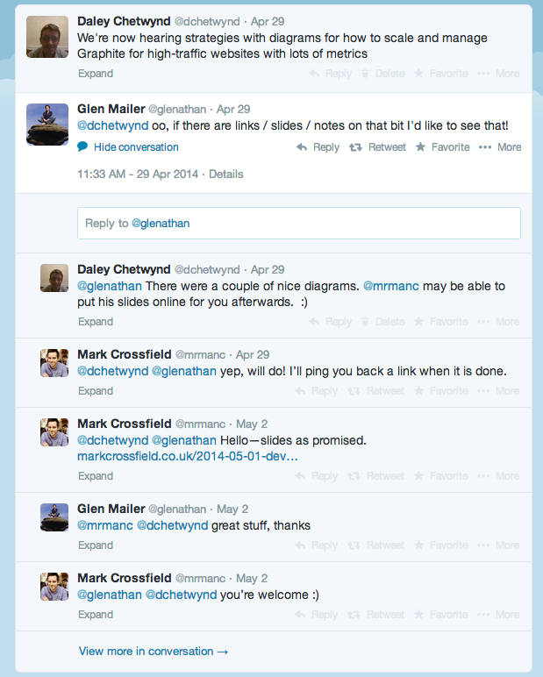
Why use Twitter?

Slide 9
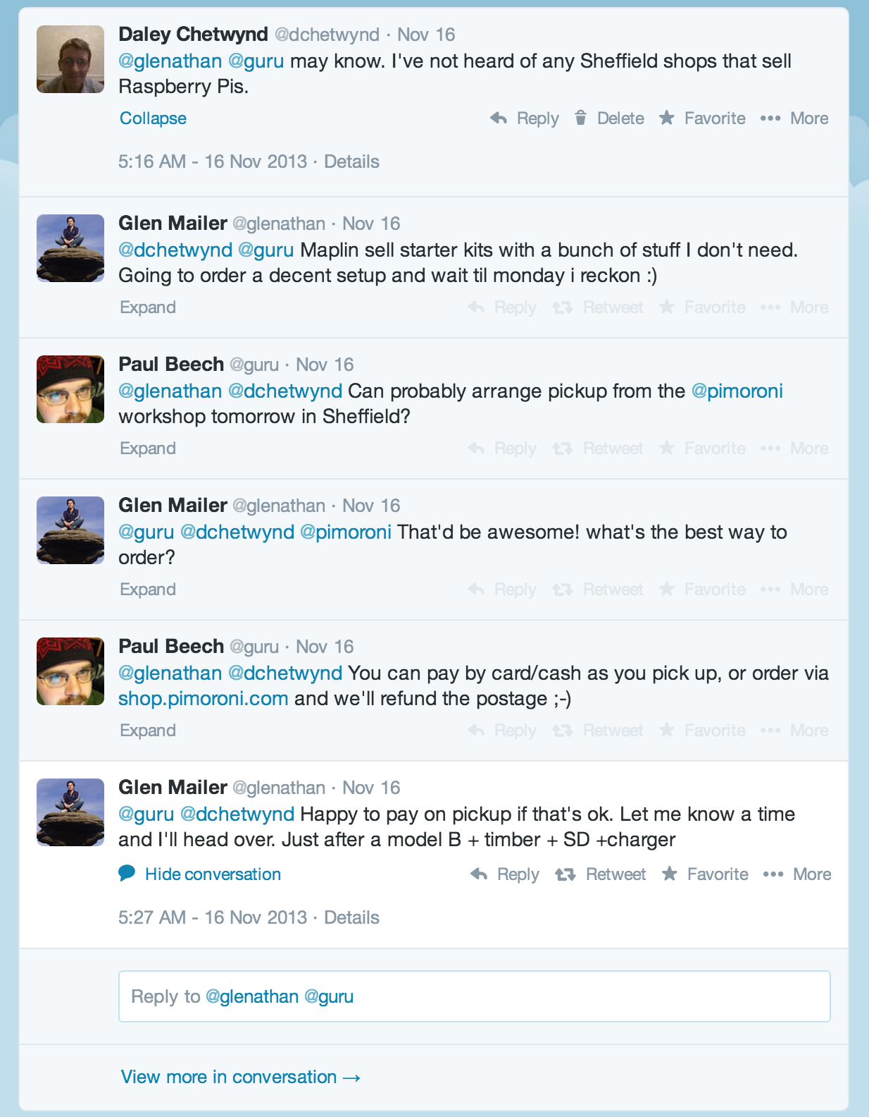
Why use Twitter?

Slide 10
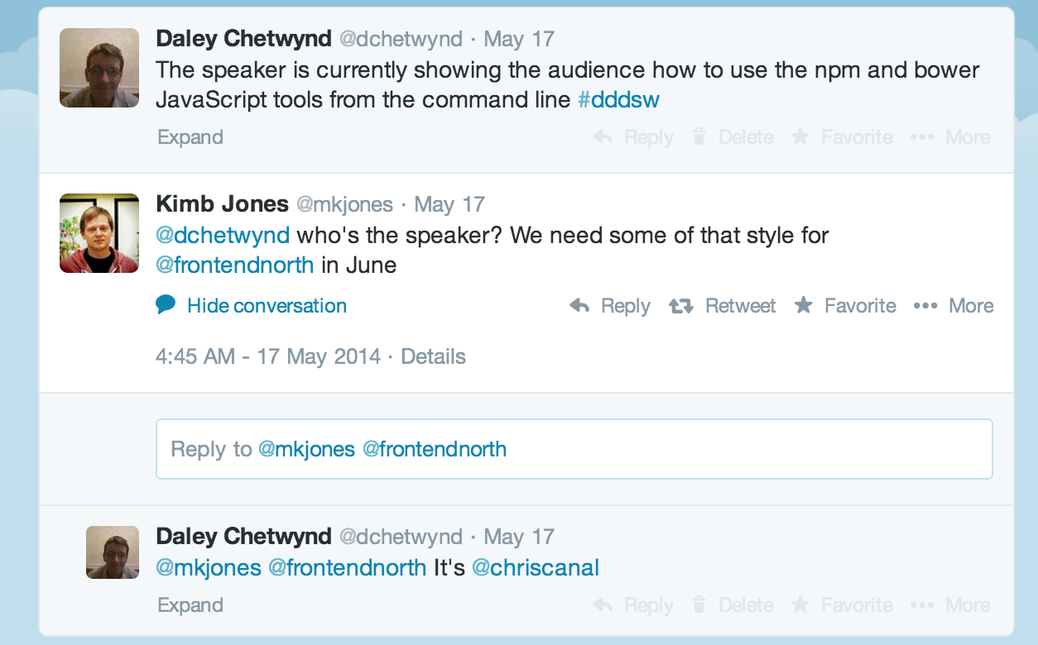
Why use Twitter?

Slide 11
Hashtags
Hashtag is label for tweet
Allowed related tweets to be grouped
Easier searching for tweets related to topic
Can be used by live event attendees to communicate
Useful for conference discussions in real-time

Slide 12
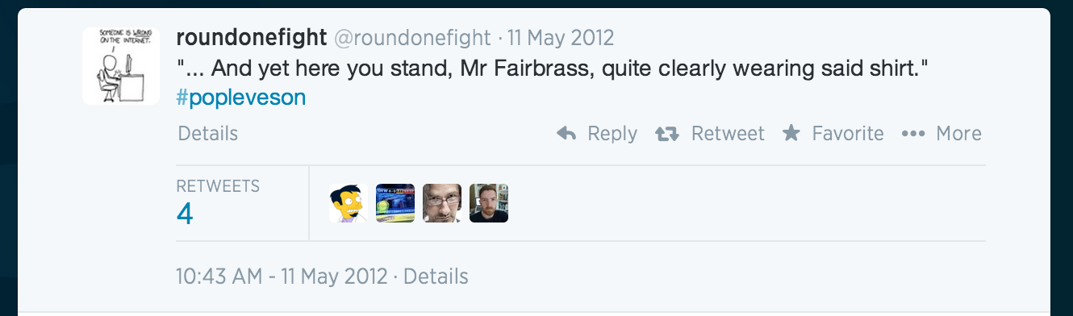
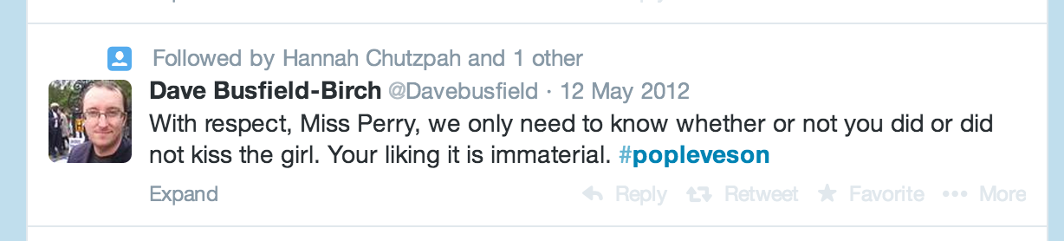
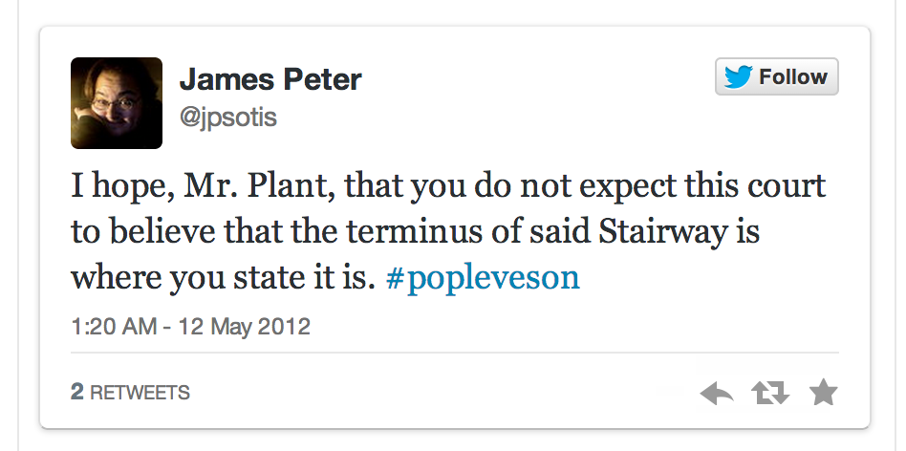
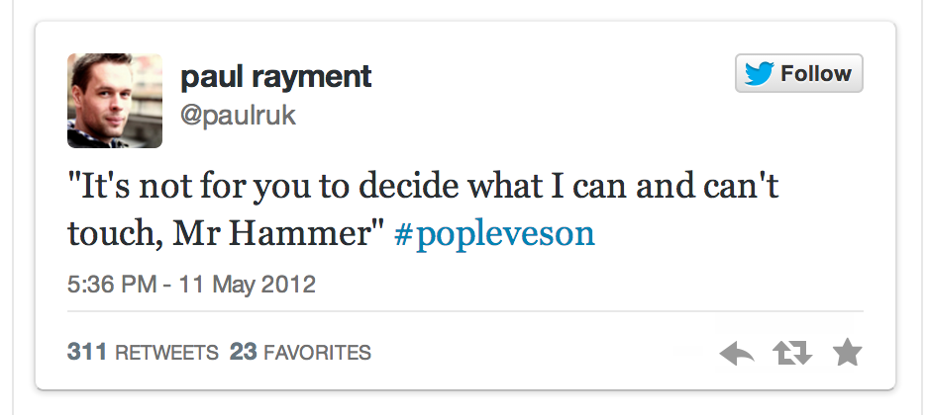
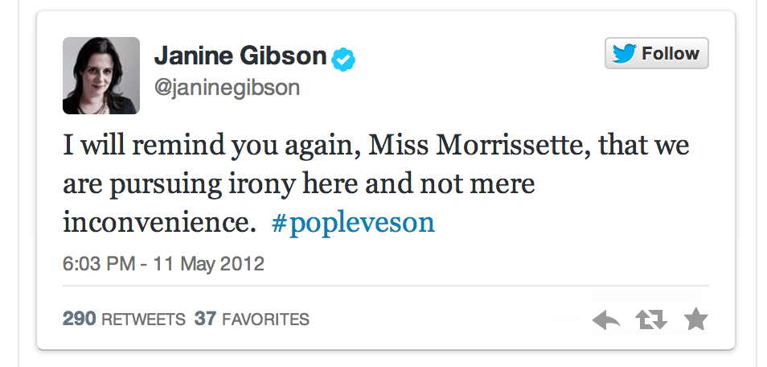
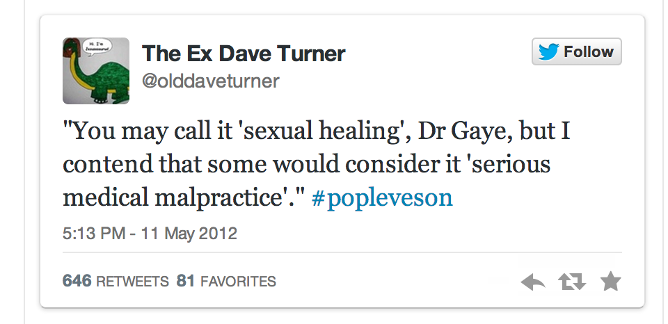
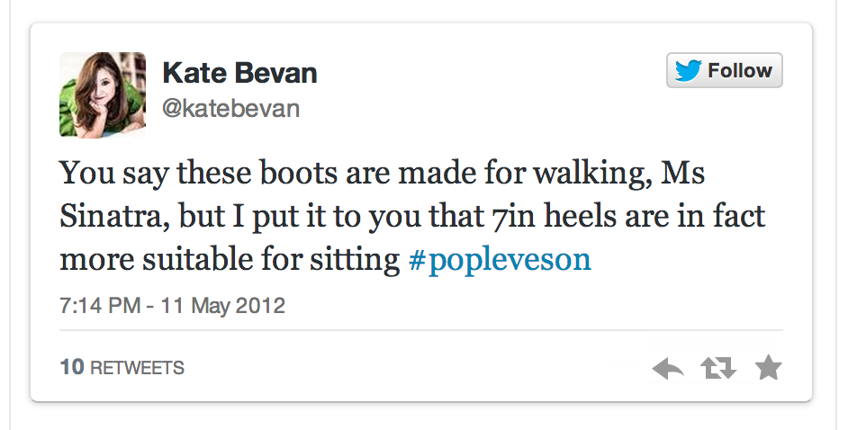
#popleveson

Slide 13
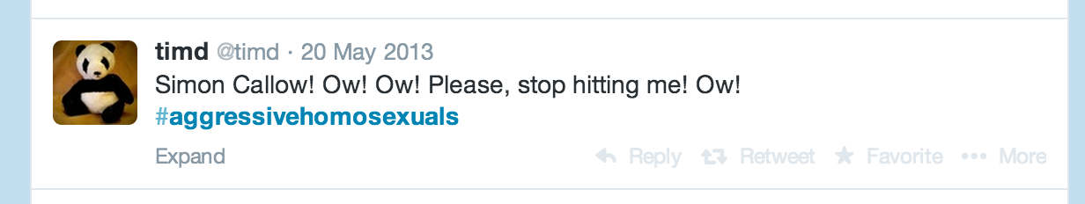
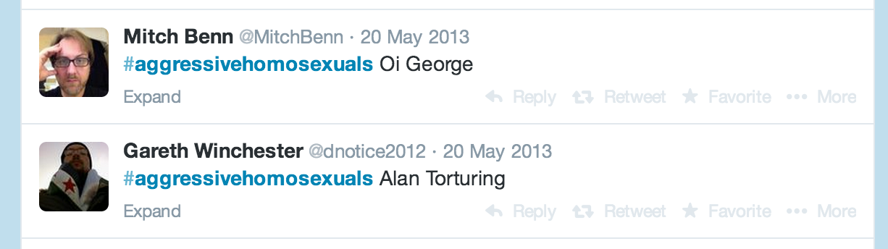
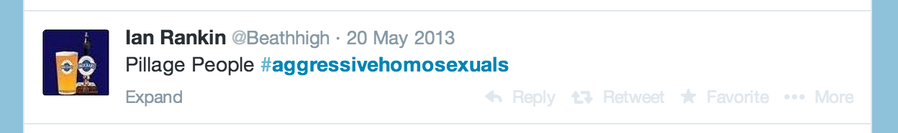
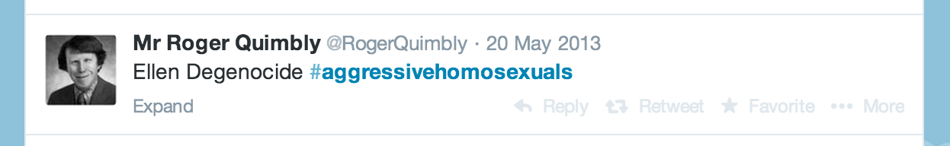
#aggressivehomosexuals

Slide 14
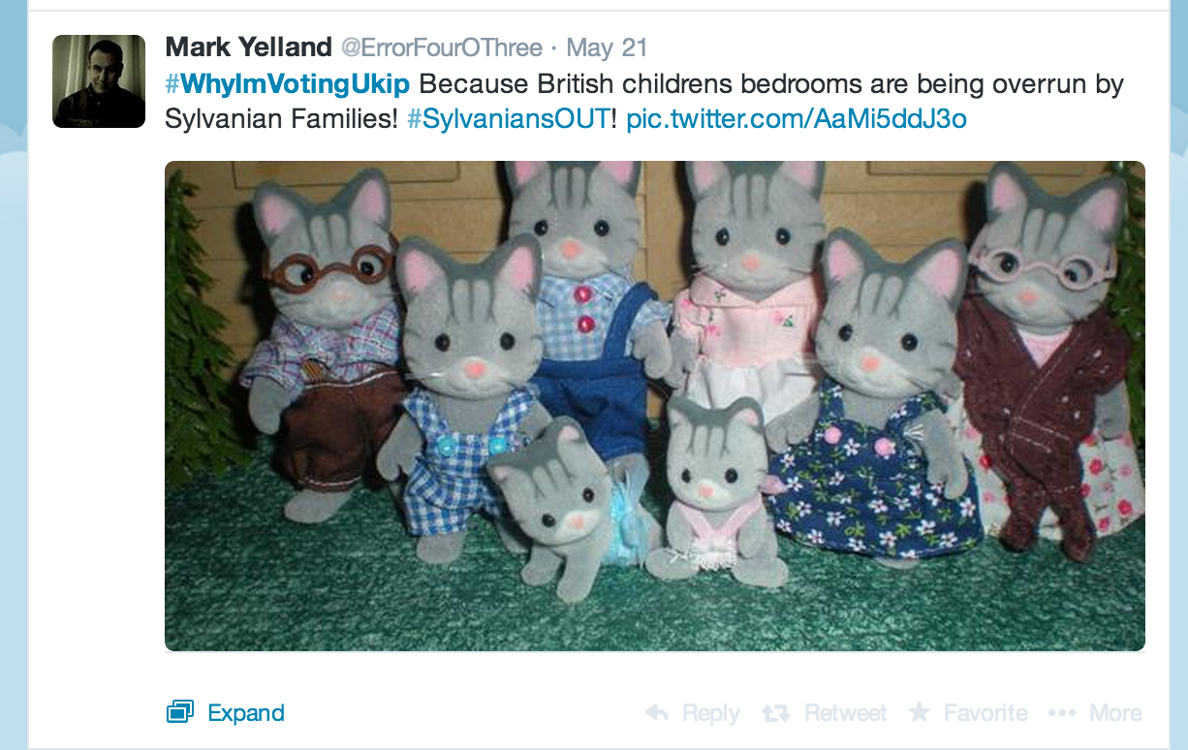
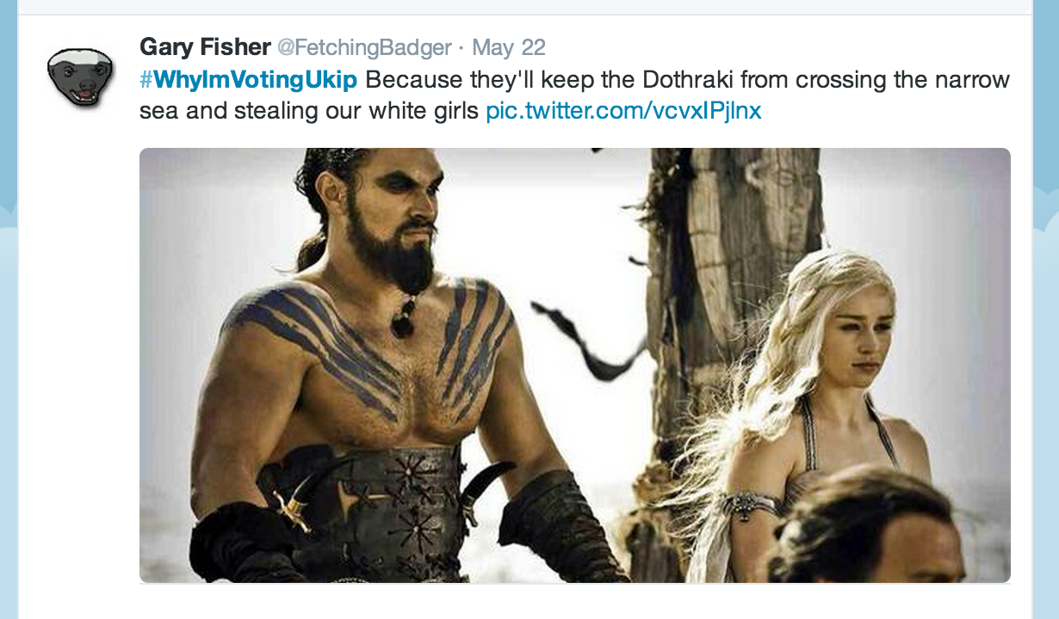
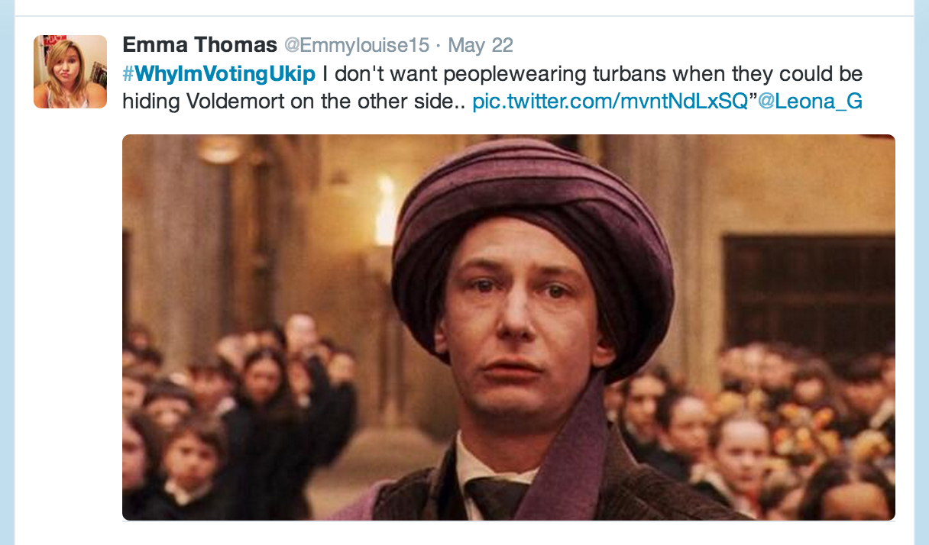
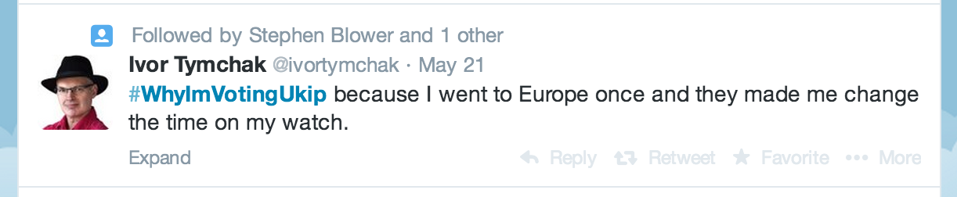
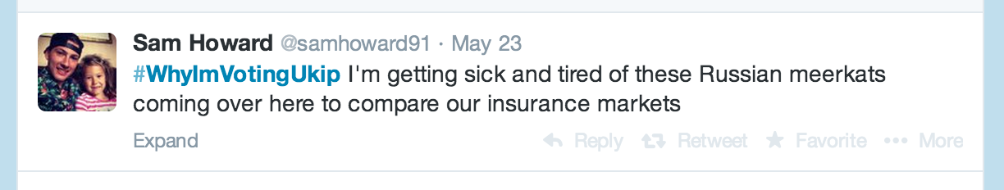
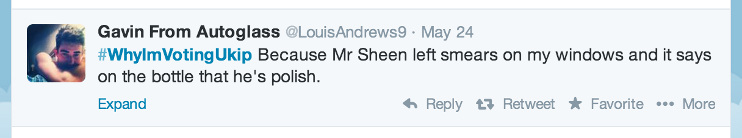
#WhyImVotingUkip

Slide 15
#YesAllWomen

Slide 16
#eurovision

Slide 17
2 Levels of Twitter
Personalised information feed (read-only)
Sharing knowledge with like-minded people

